Slide 1
Software Design & Architecture
Lecture # 09
Object Design and UML Interaction Diagrams

Slide 2
Outline
Object Design
Static and Dynamic Modeling
UML Interaction Diagrams
Sequence Diagrams
Communication Diagrams

Slide 3
Design
How do developers design objects? Here are three ways:
Code. Design-while-coding (Java, C#, …), ideally with power tools such as re-factorings. From mental model to code.
Draw, then code. Drawing some UML on a whiteboard or UML CASE tool, then switching to #1 with a text-strong IDE (e.g., Eclipse or Visual Studio).
Only draw. Somehow, the tool generates everything from diagrams.
Agile Modeling and Lightweight UML Drawing

Slide 4
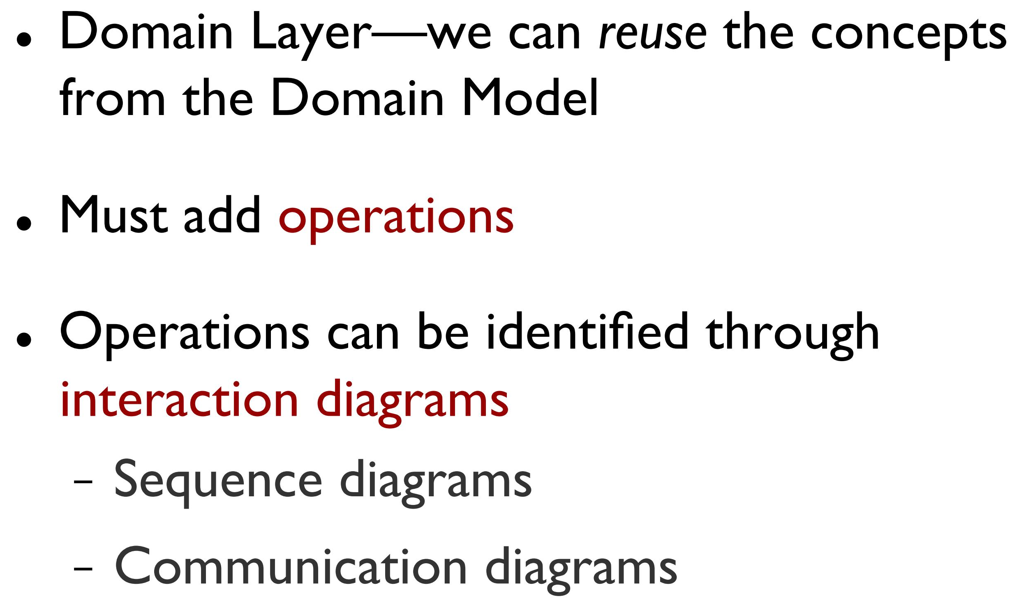
Getting the Objects

Slide 5
Static and Dynamic Modeling
Dynamic models, such as UML interaction diagrams (sequence diagrams or communication diagrams), help design the logic, the behavior of the code or the method bodies
most of the challenging, interesting, useful design work happens while drawing the UML dynamic-view interaction diagrams
Static models, such as UML class diagrams, help design the definition of packages, class names, attributes, and method signatures (but not method bodies).
The most common static object modeling is with UML class diagrams
Spend significant time doing interaction diagrams, not just class diagrams.
it's especially during dynamic modeling that we apply responsibility-driven design and the GRASP principles

Slide 6
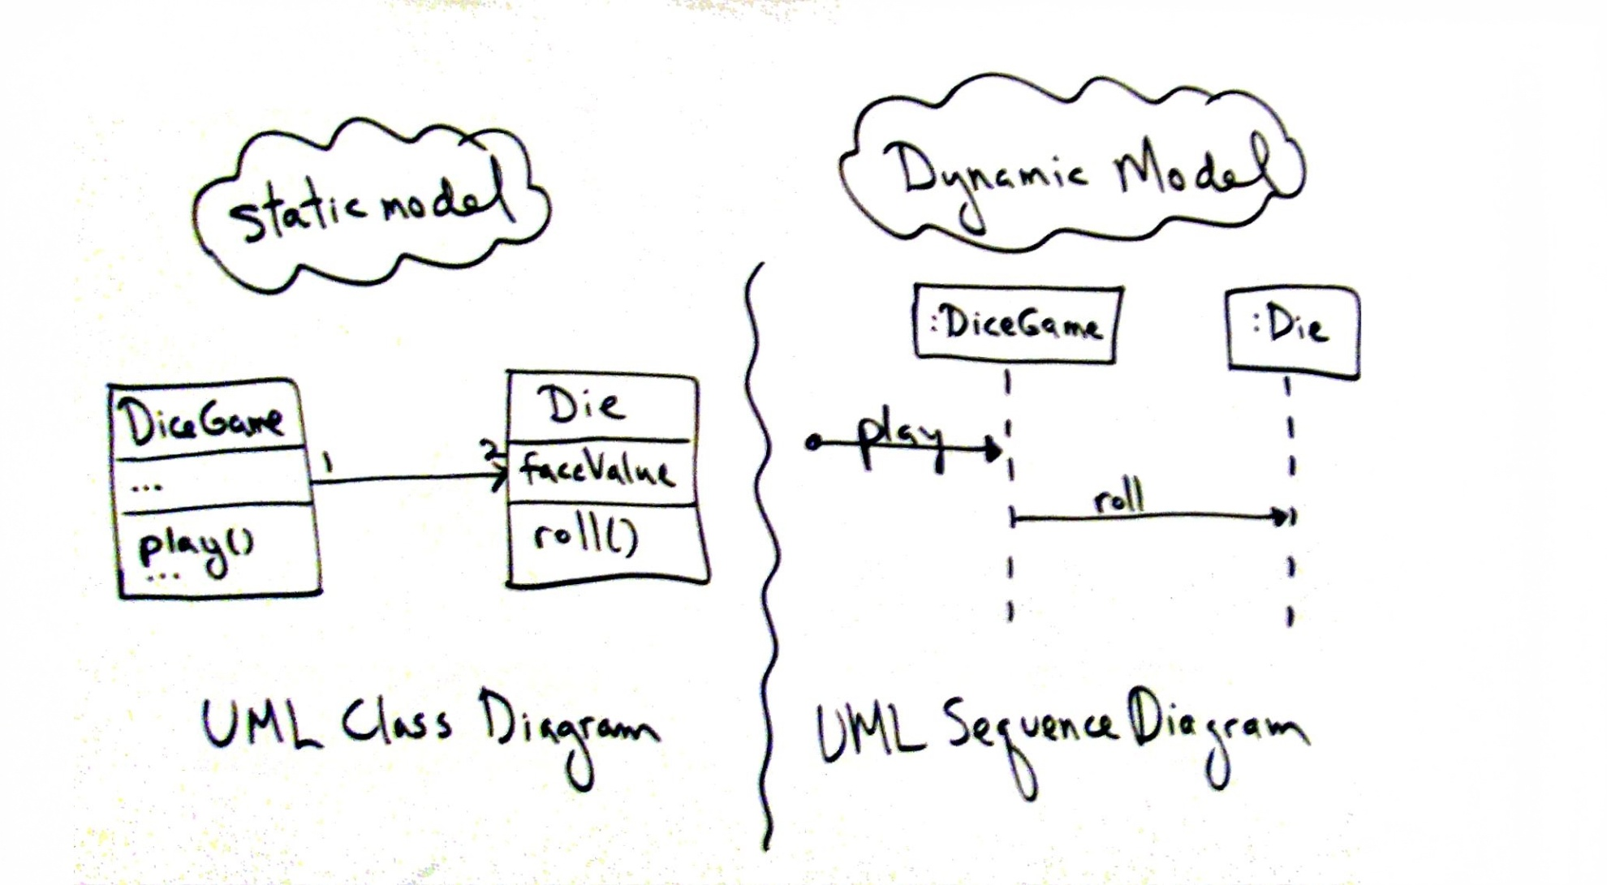
Static and Dynamic Modeling

Slide 7
Object Design Skill vs. UML Notation Skill
Drawing UML is a reflection of making decisions about the design.
The object design skills are what matter, not knowing how to draw UML.
Fundamental object design requires knowledge of:
principles of responsibility assignment
design patterns

Slide 8
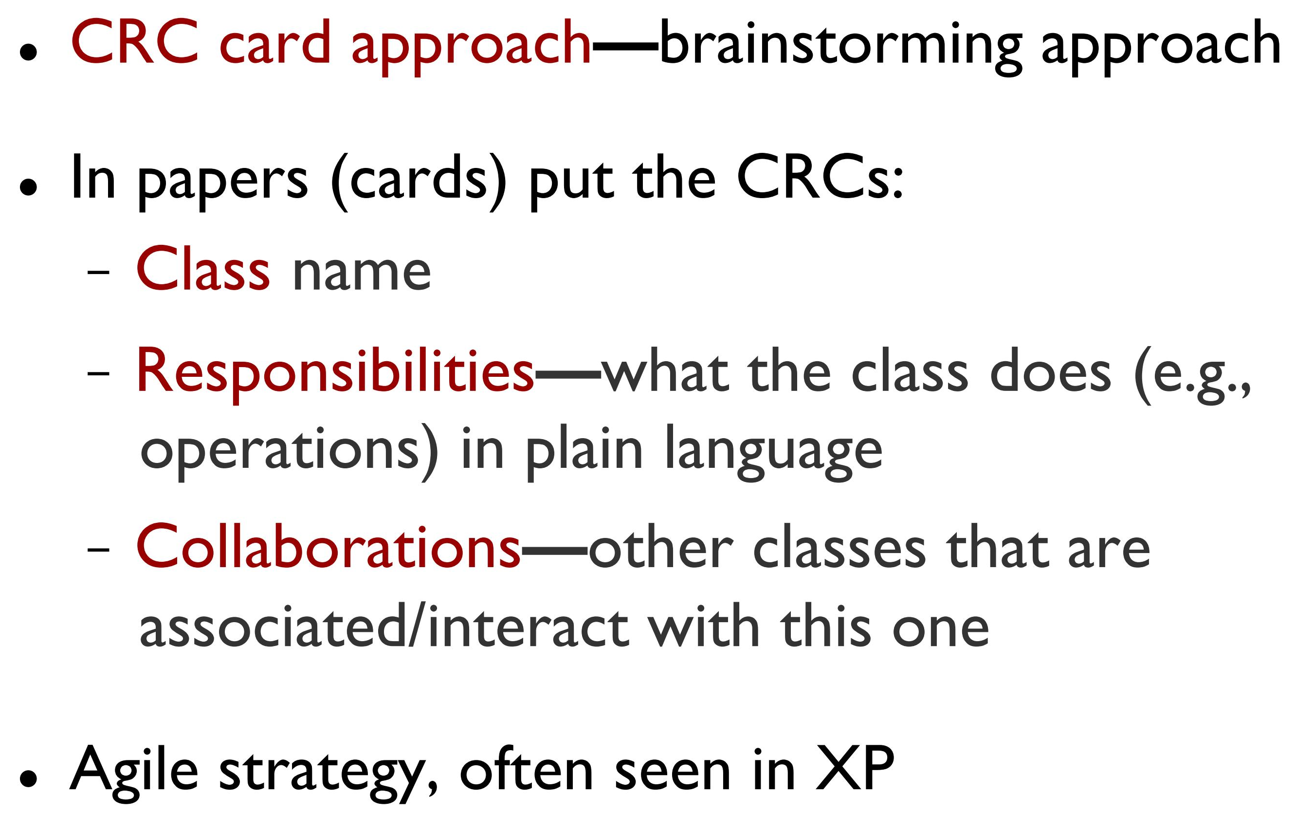
Other Object Design Techniques: CRC (Class Responsibility Collaboration) Cards

Slide 9
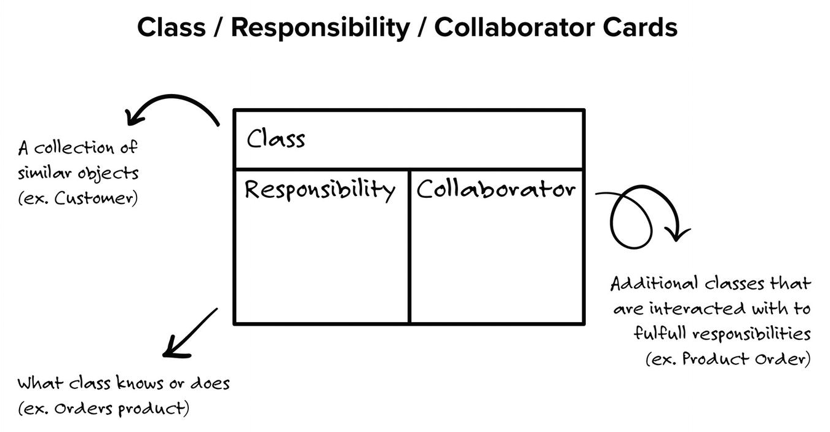
Other Object Design Techniques: CRC (Class Responsibility Collaboration) Cards

Slide 10
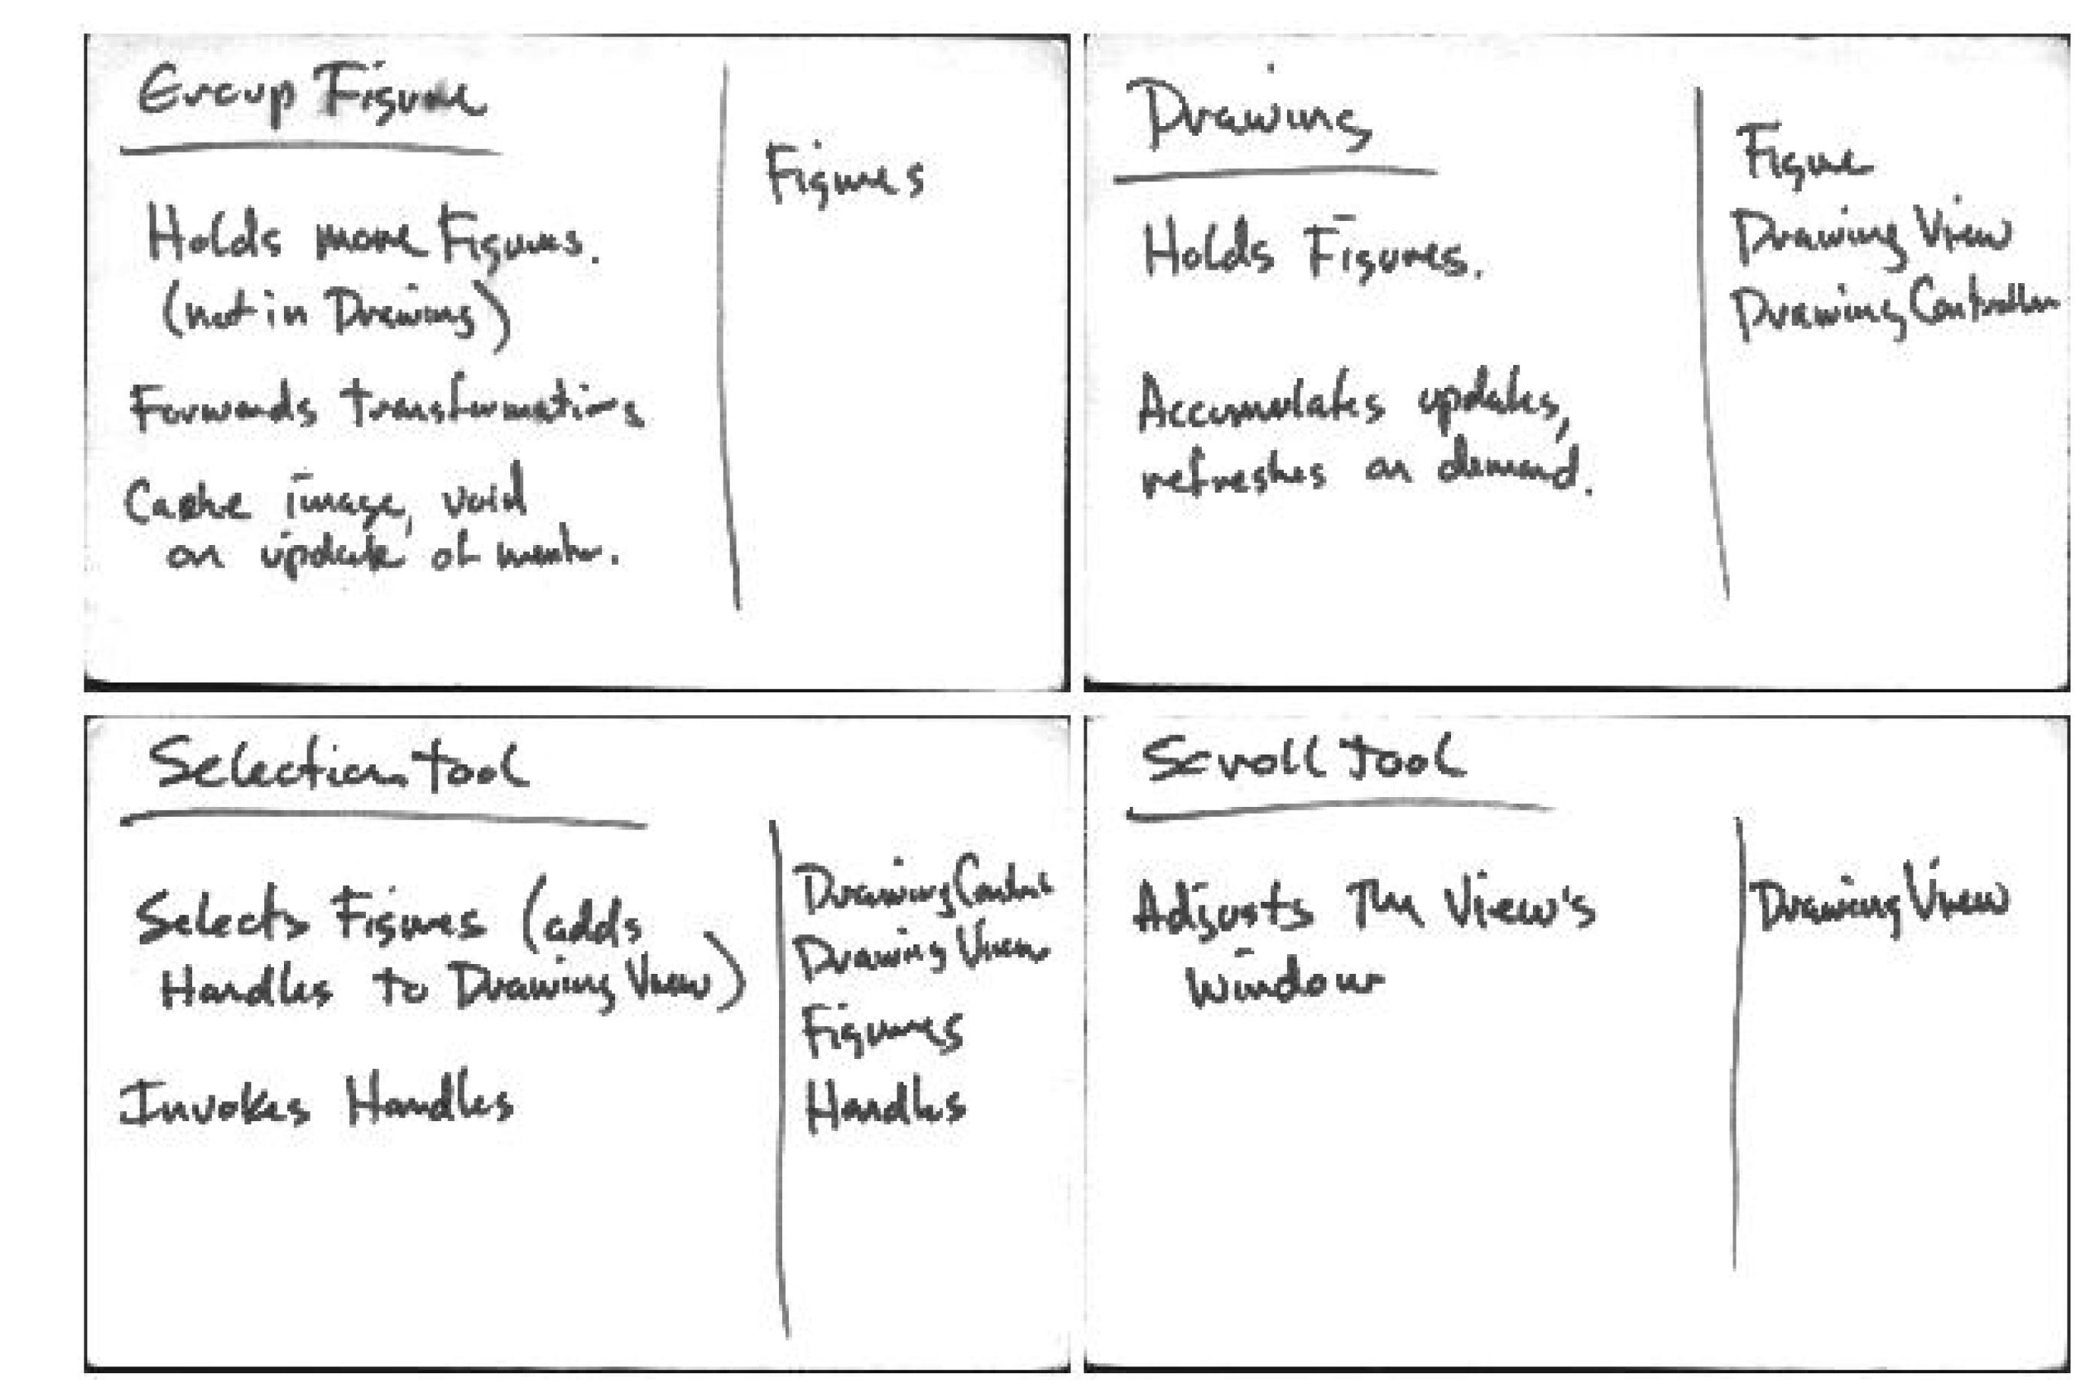
Other Object Design Techniques: CRC (Class Responsibility Collaboration) Cards

Slide 11
Dynamic Modeling
UML Interaction Diagrams

Slide 12
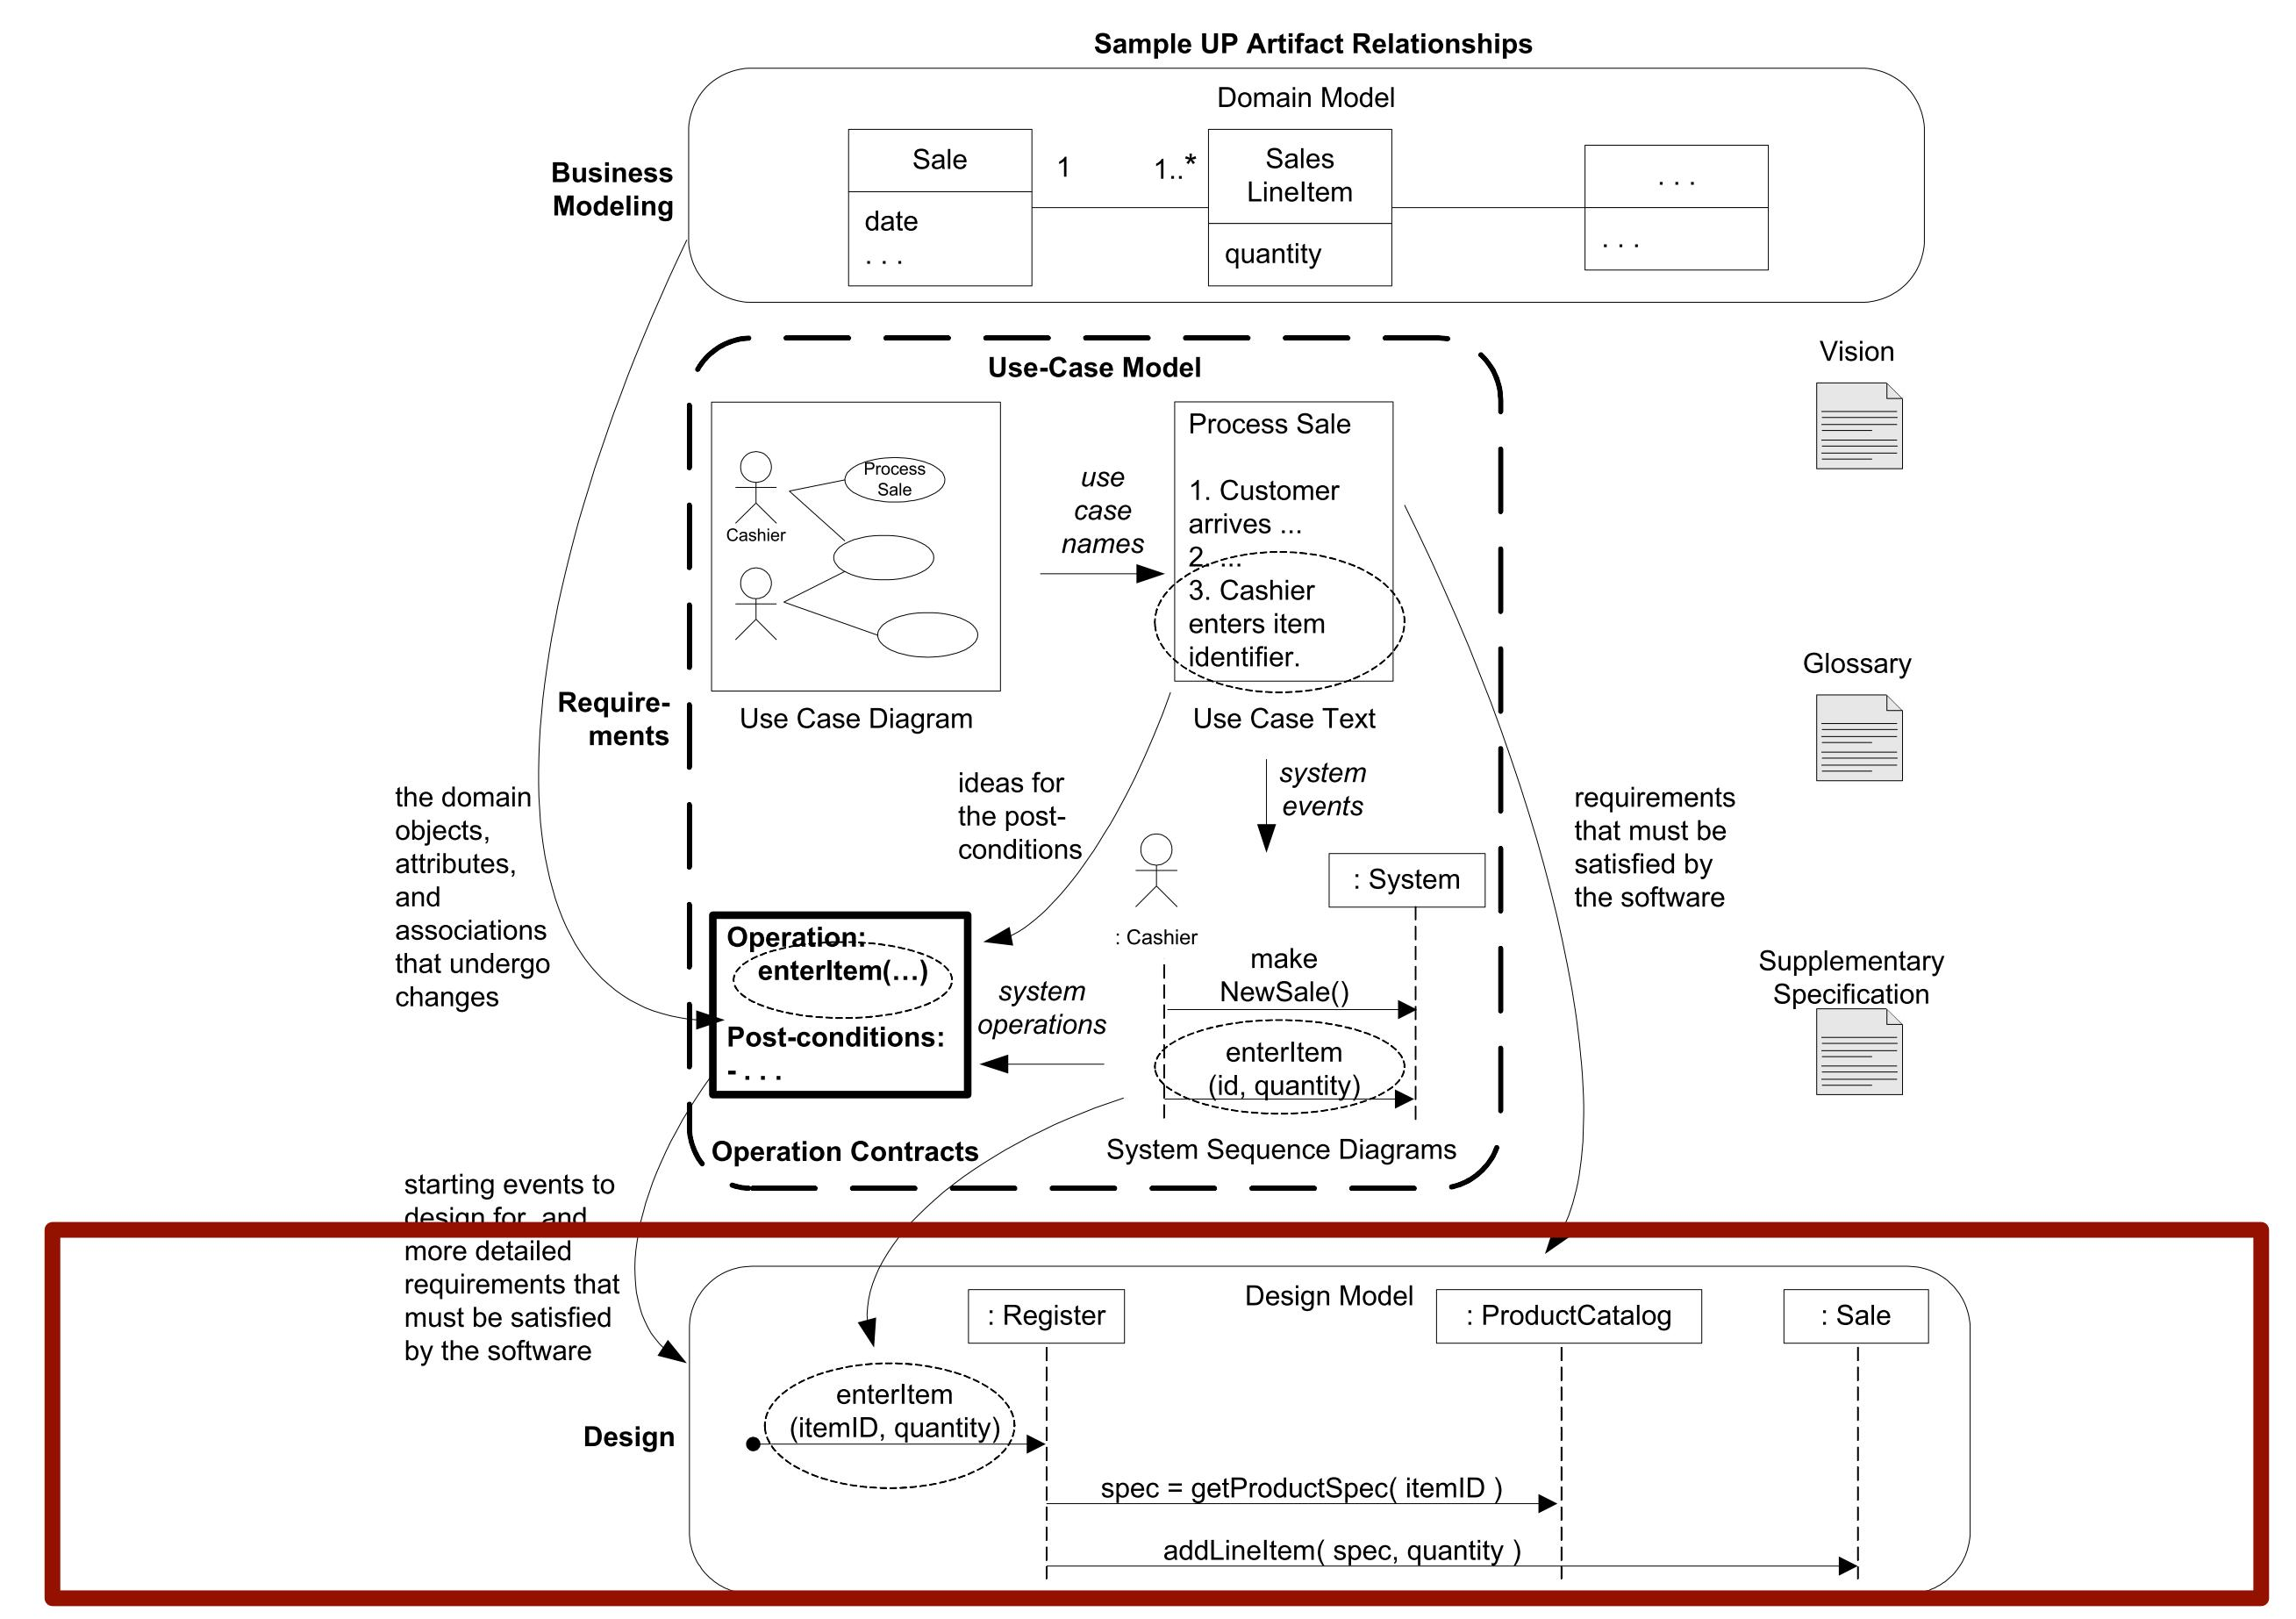
Design Road

Slide 13
Interaction Diagrams
UML includes interaction diagrams to illustrate how objects interact via messages
The term interaction diagram is a generalization of two more specialized UML diagram types:
sequence diagrams
communication diagrams
A related diagram is the interaction overview diagram; it provides a big-picture overview of how a set of interaction diagrams are related in terms of logic and process-flow
New addition in UML 2.0
Sequence diagrams are the more notationally rich of the two types, but communication diagrams have their use as well, especially for wall sketching.

Slide 14
Sequence Diagram
Sequence diagram’s ‘fence’ format
Time is increasing in the downward direction

Slide 15
Sequence Diagram
public class A
{
private B myB = new B();
public void doOne()
{
myB.doTwo();
myB.doThree();
}
}

Slide 16
Communication Diagrams
Same collaboration using communication diagram
Uses network (or graph) format

Slide 17
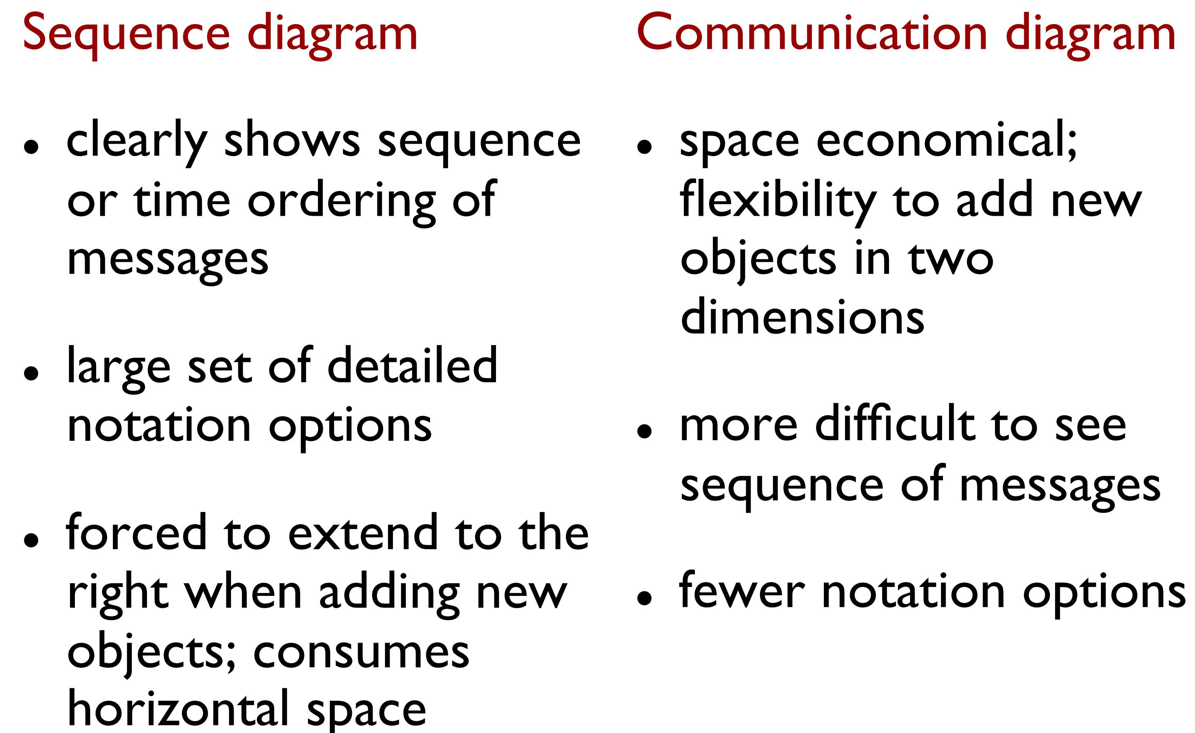
Interaction Diagrams

Slide 18
Interaction Diagrams
Sequence vs. Communication diagrams
Sequence Diagrams
Easier to see sequence of method calls over time
More expressive UML notation
Better support from many tools
Communication Diagrams
Better fit on limited space (page or whiteboard)
Easier to edit/amend

Slide 19
Example Sequence Diagram: makePayment
Someone(?) sends makePayment(..) msg to Register
Register sends makePayment(..) msg to Sale
Sale creates an instance of Payment
Who created Register & Sale? IDs show a fragment of system behavior
during isolated snapshot in time. This can be confusing and lead to
modeling errors/omissions!

Slide 20
Code
public class Sale
{
private Payment payment;
public void makePayment( Money cashTendered )
{
payment = new Payment( cashTendered );
//…
}
// …
}

Slide 21
Communication Diagram
Same collaboration using communication diagram

Slide 22
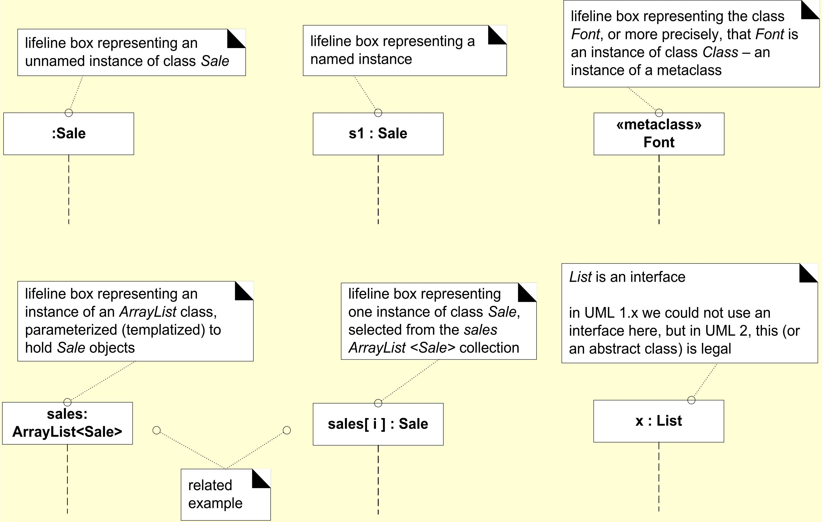
Lifeline boxes to show participants in interactions

Slide 23
Interaction Diagrams
Message expression syntax
Don’t have to use full syntax in all cases
return = msgName(param:paramType1, …) : returnType
Examples:
initialize(code)
initialize
d = getProductDescription(id)
d = getProductDescription(id:ItemID)
d = getProductDescription(id:ItemID) : ProductDescription

Slide 24
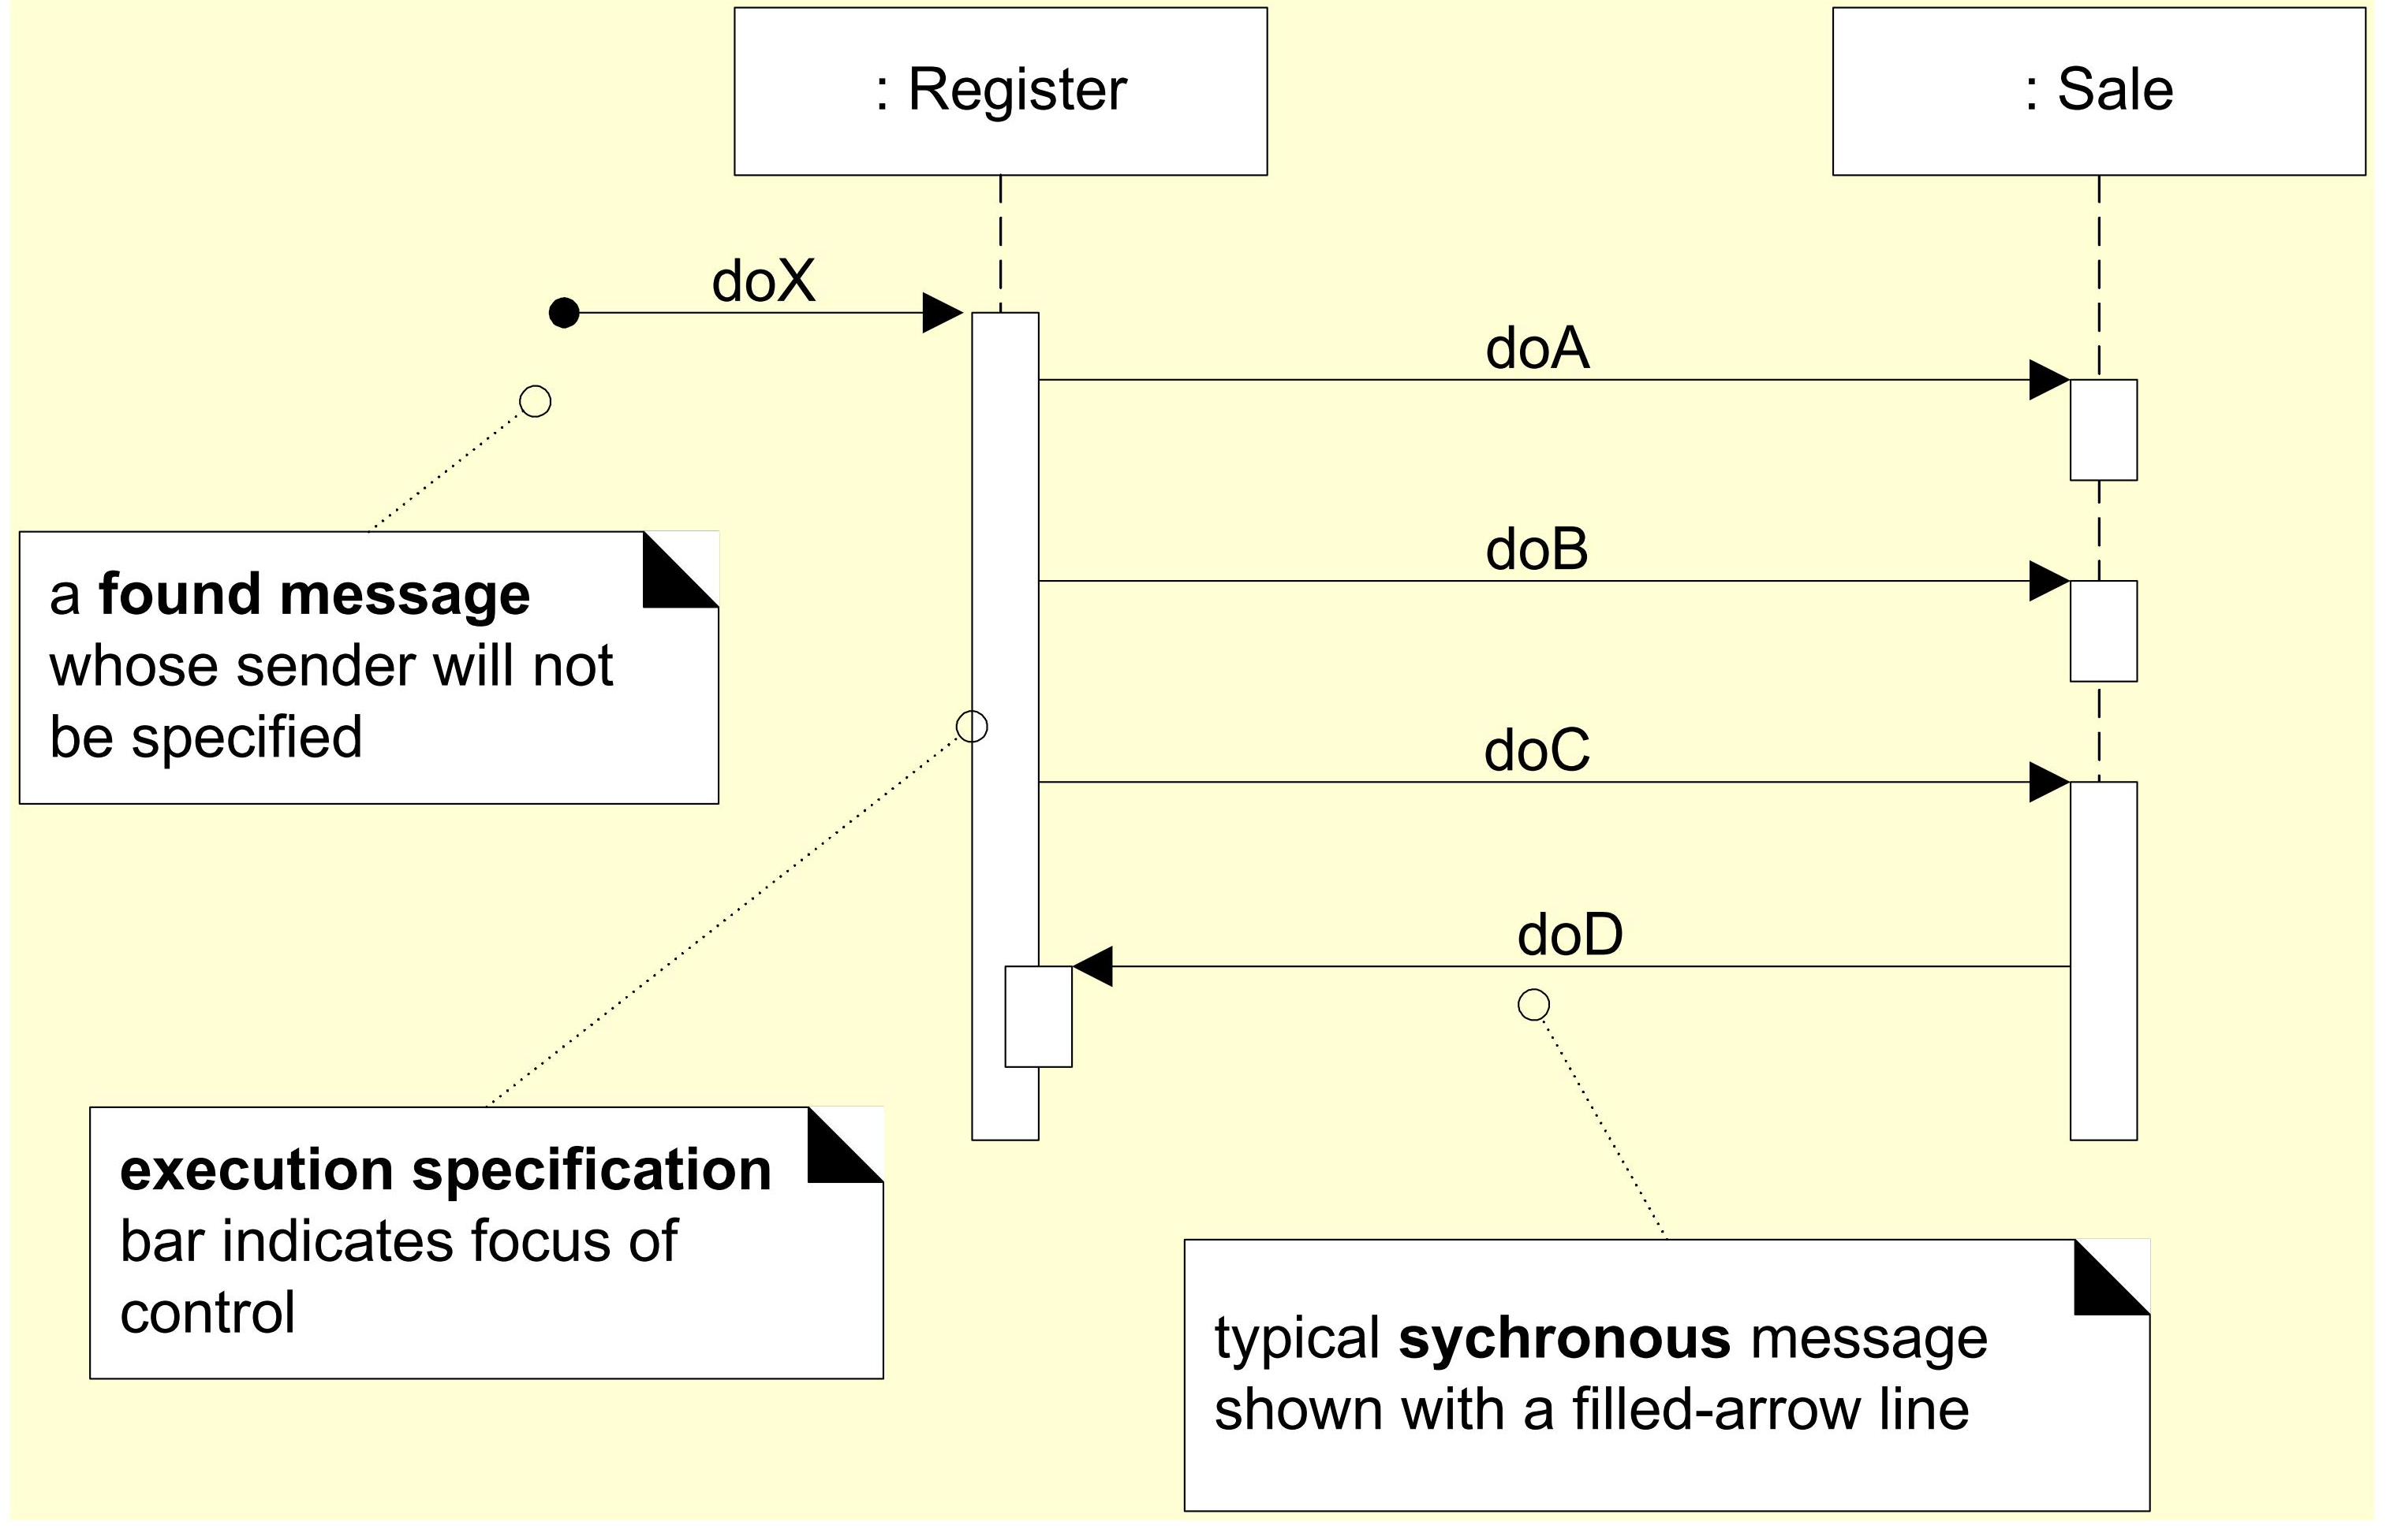
Basic Sequence Diagram Notation

Slide 25
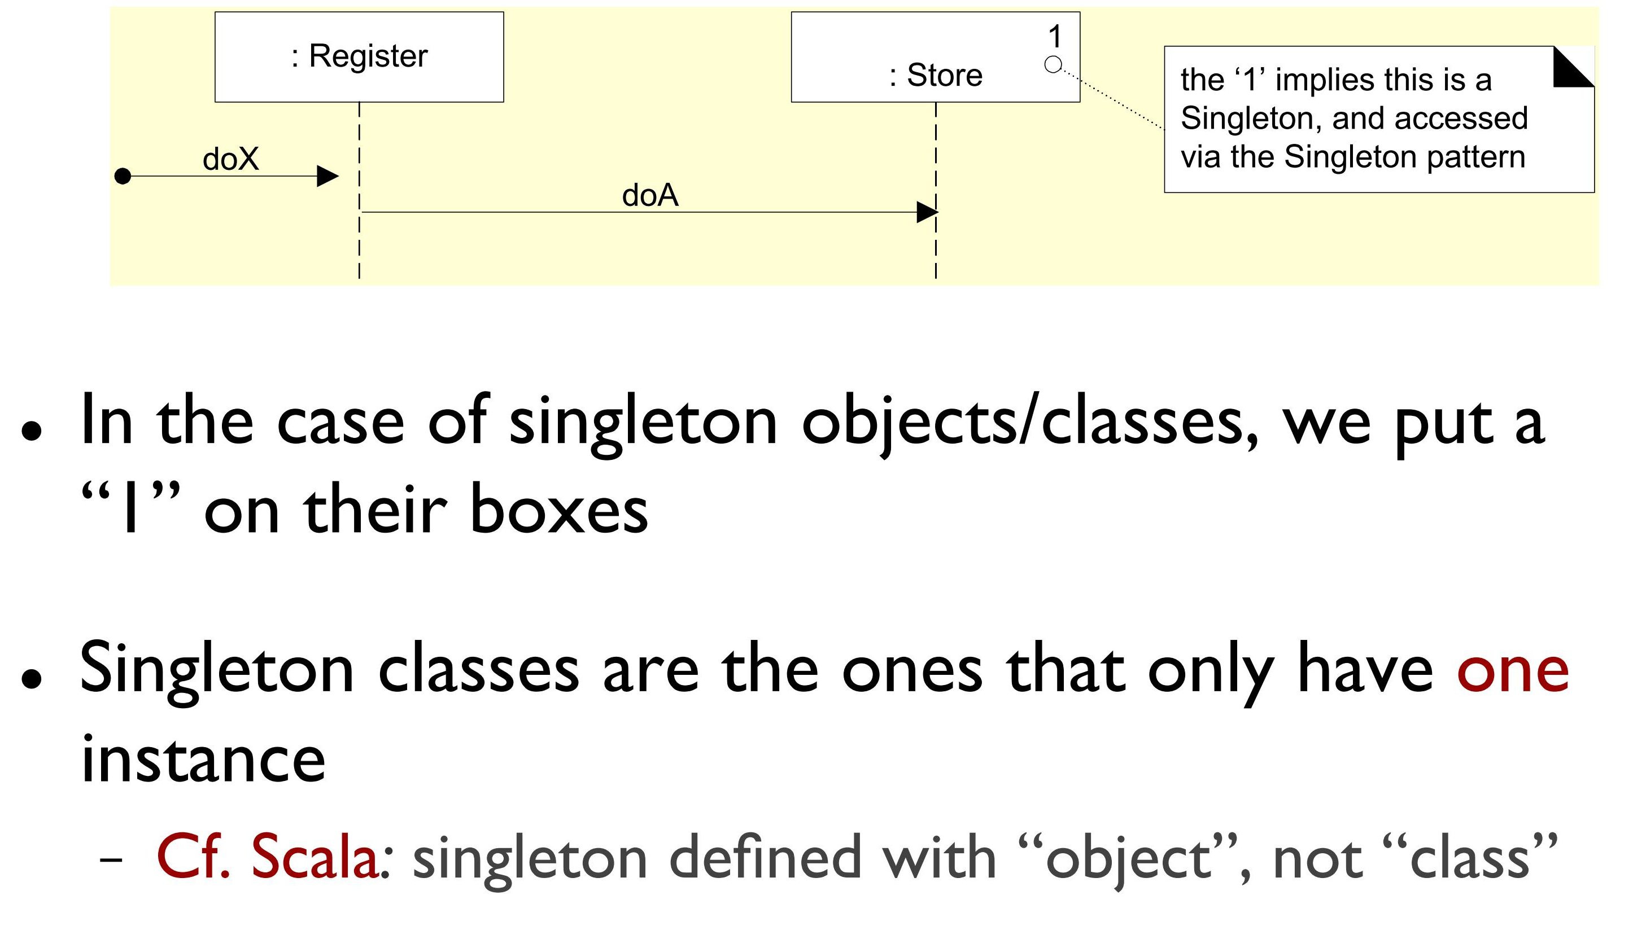
Singleton Objects

Slide 26
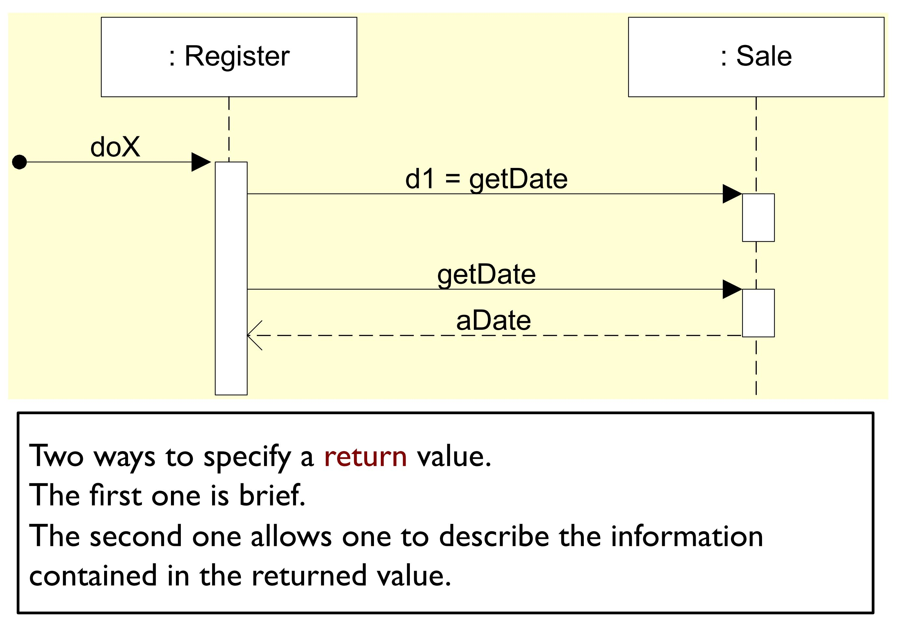
Illustrating Reply or Returns
More common return syntax
A return from method call, usually considered optional

Slide 27
Messages to "self" or "this"
Objects commonly invoke their own methods

Slide 28
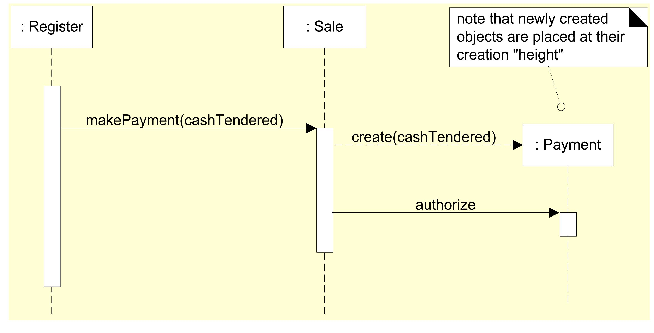
Creation of Instances
Dashed line for ‘create’ really not needed, though its now official UML
Use ‘create’ for calls to a constructor

Slide 29
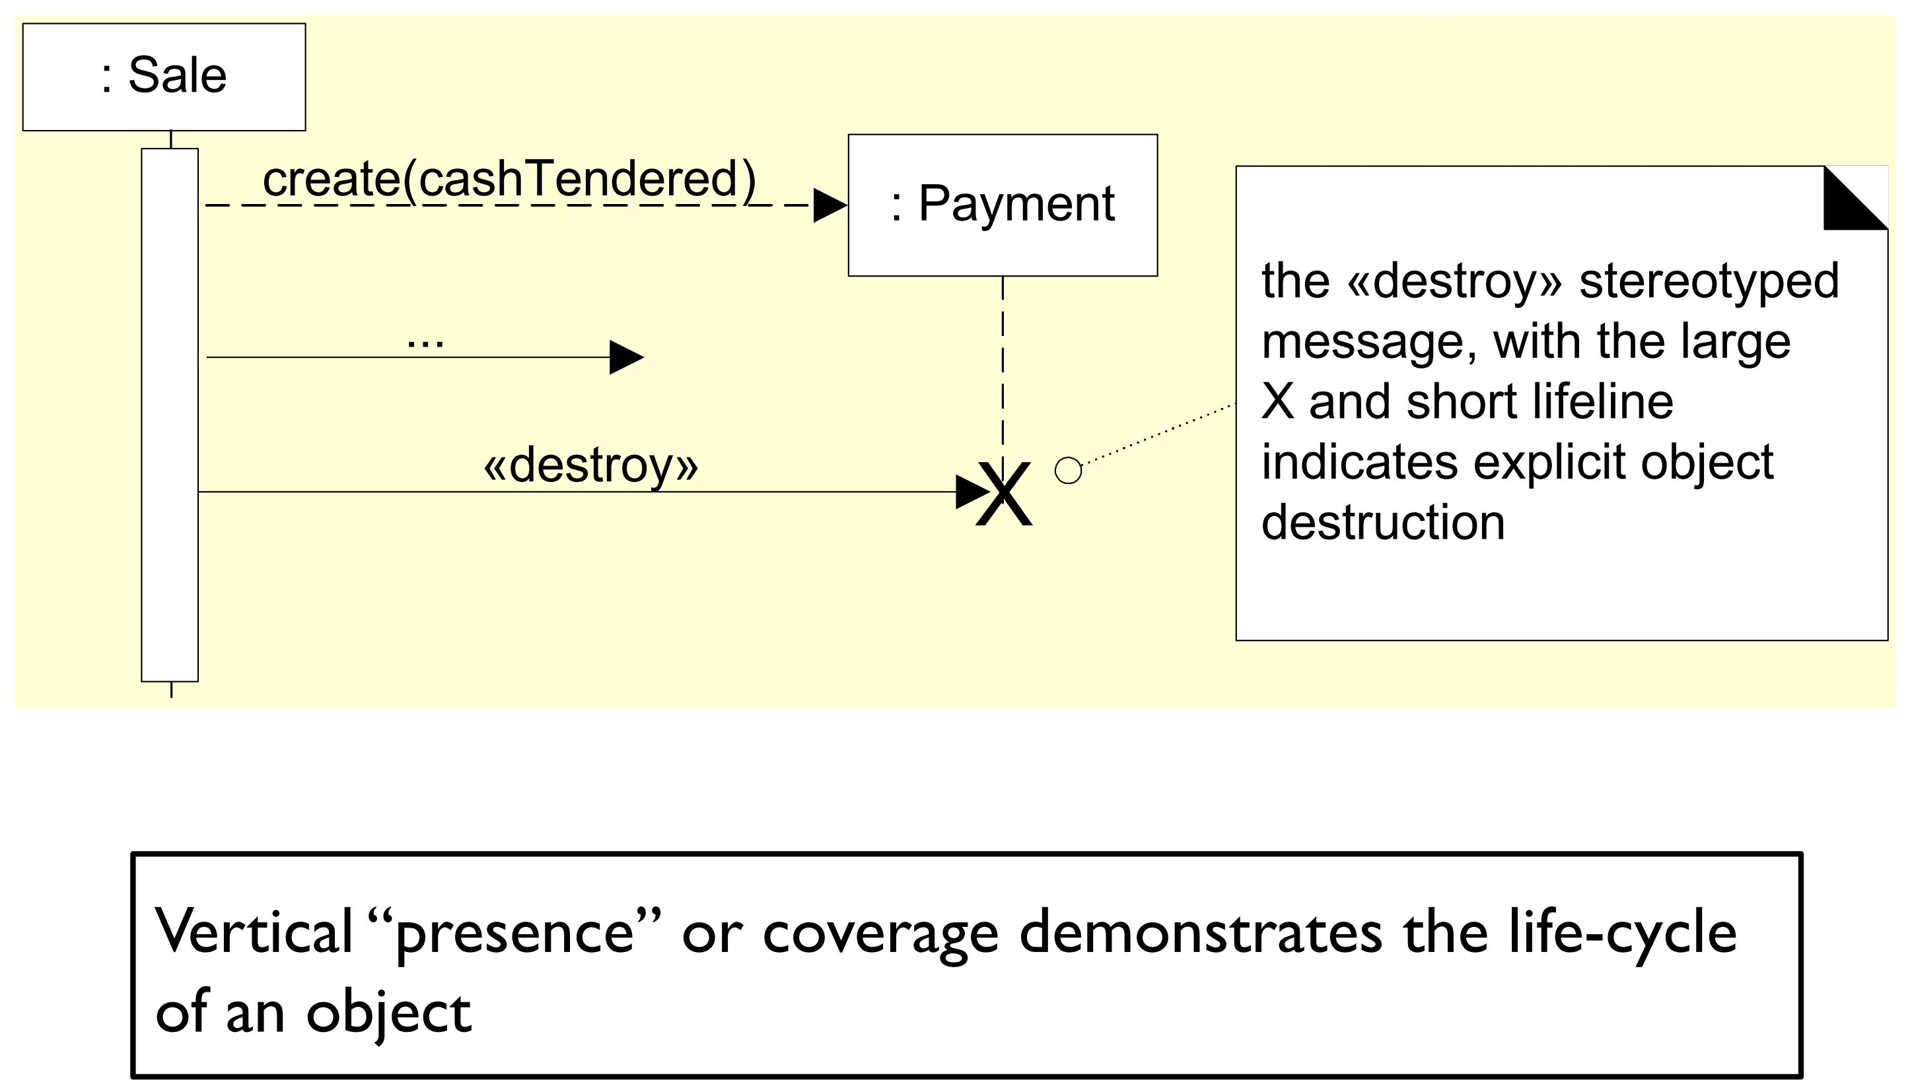
Object Lifelines and Object Destruction
Usually not necessary for languages with automatic garbage collection (e.g., Java)

Slide 30
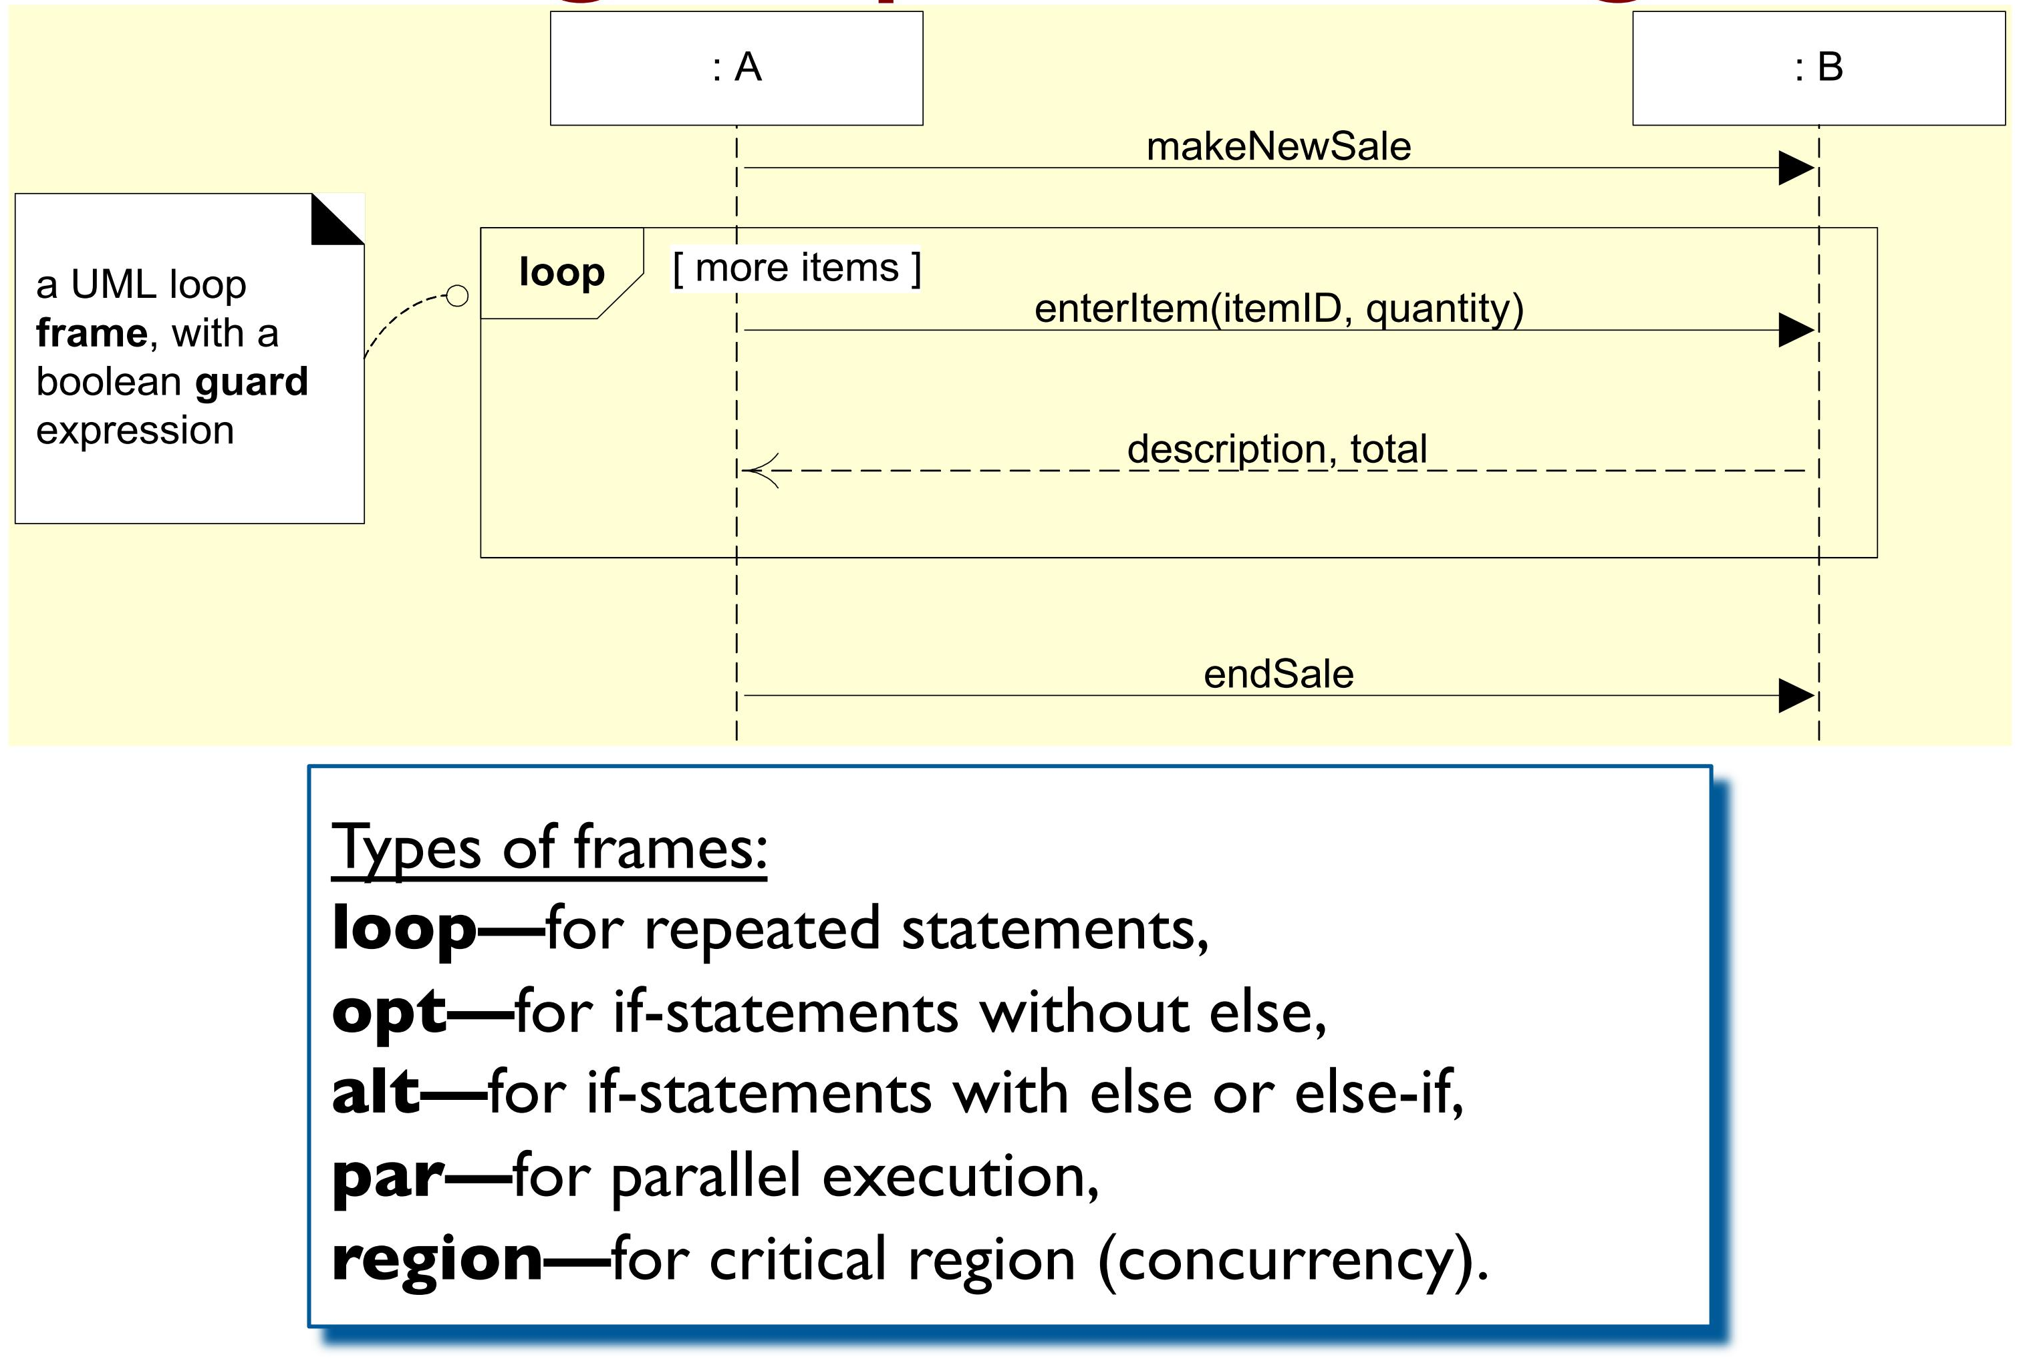
Diagram Frames in UML Sequence Diagrams
Looping

Slide 31
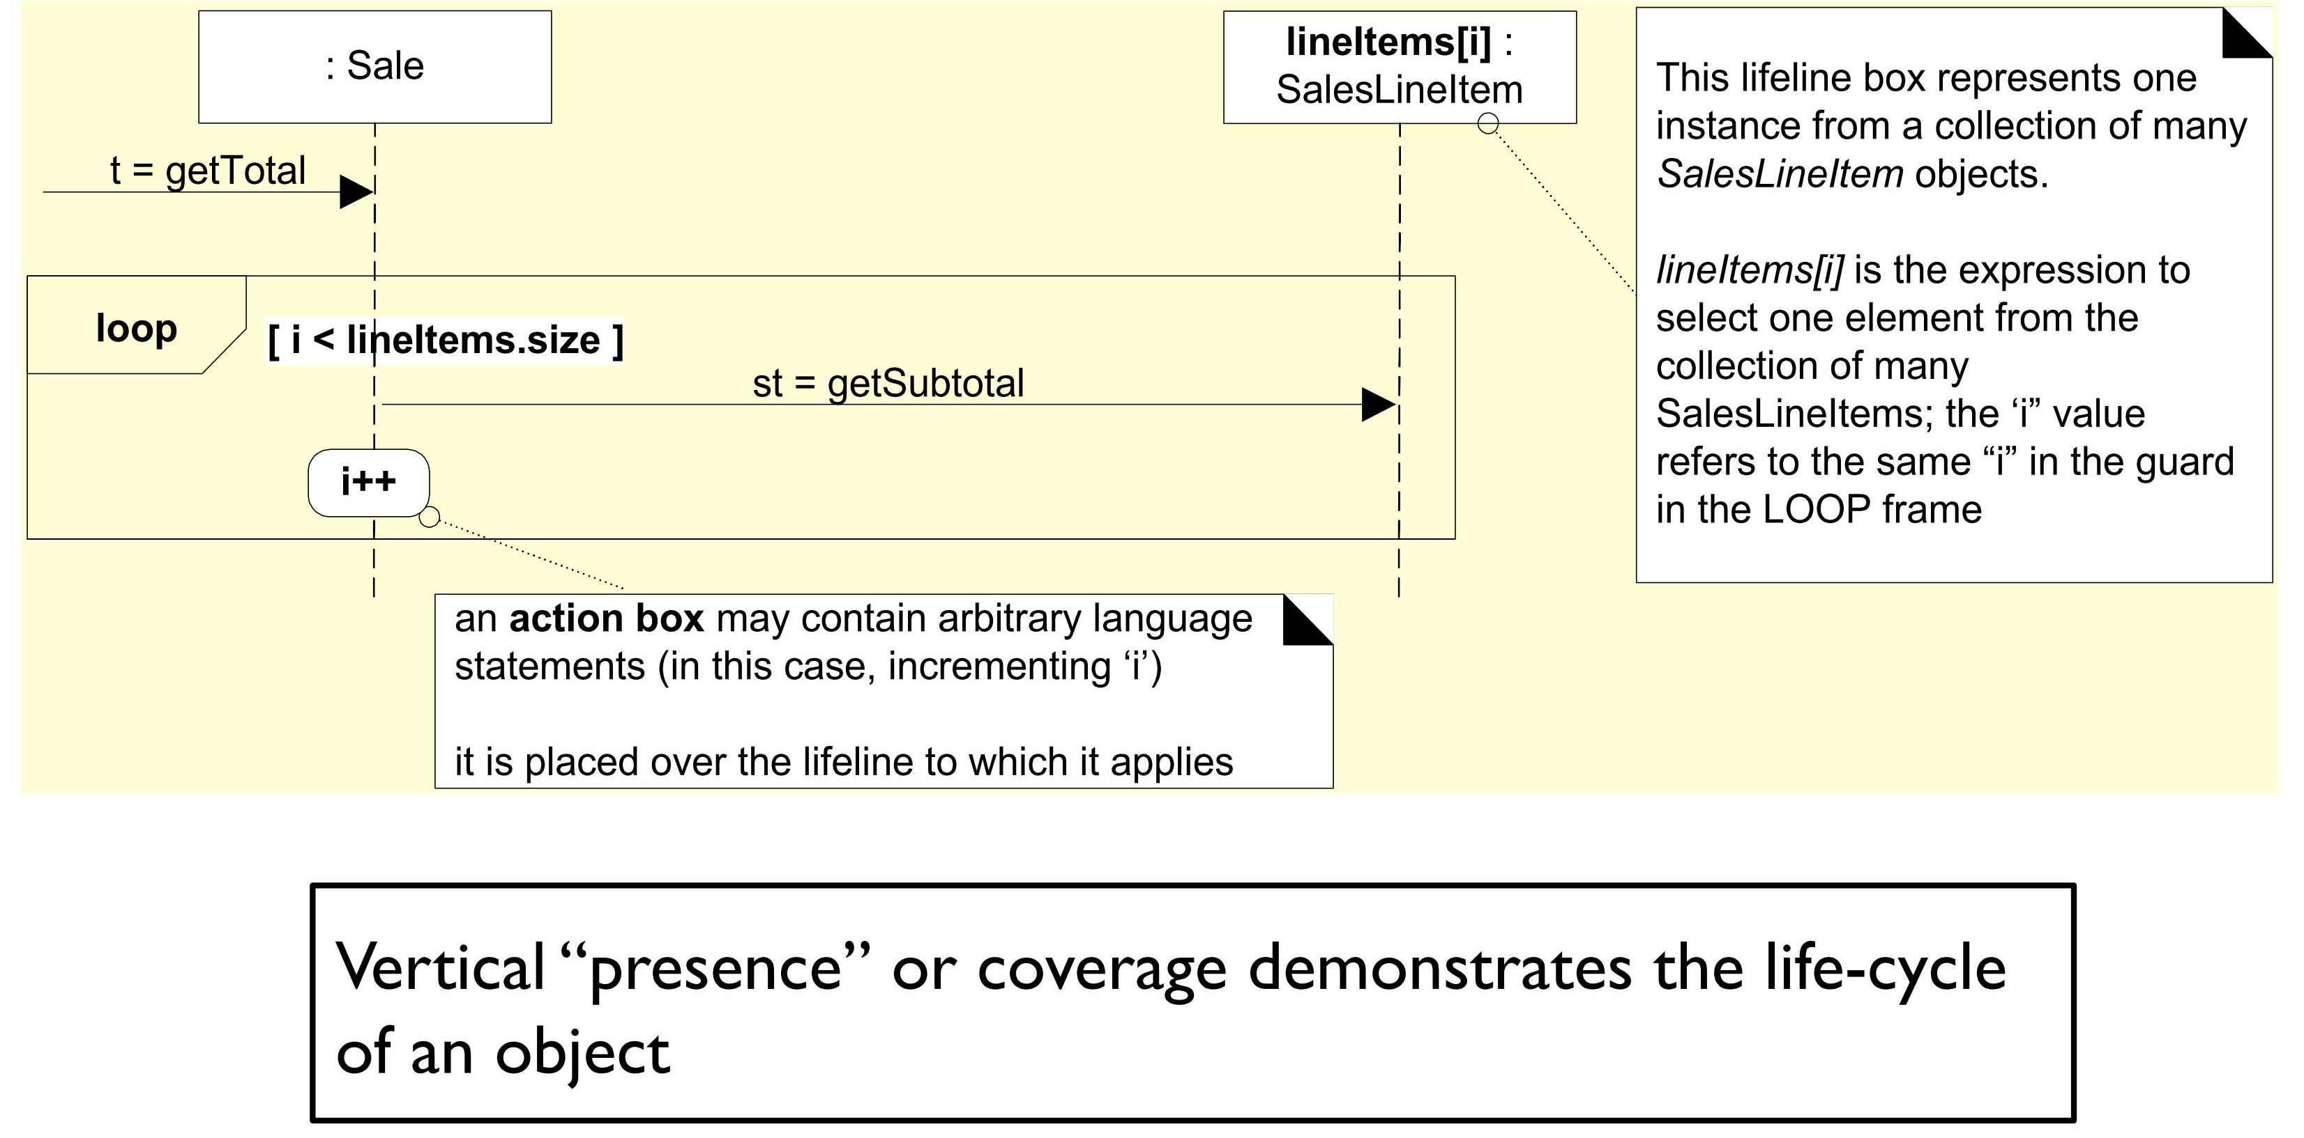
Loops in Sequence Diagrams

Slide 32
Conditional Messages
UML 2 frame showing an optional message

Slide 33
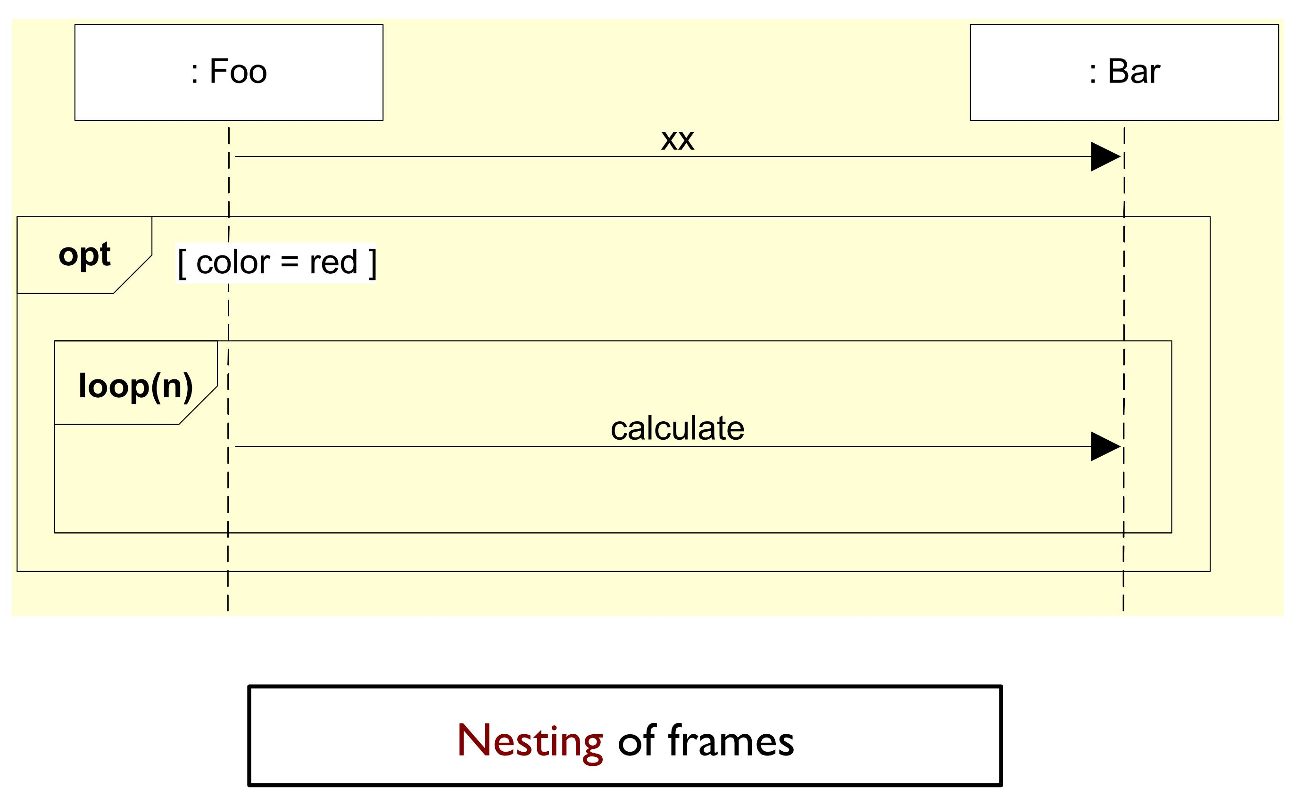
Nesting Frames in Sequence Diagrams

Slide 34
Conditional Messages in UML 1.x Style Still Useful?
The same interaction diagram using pre-UML 2 notation
Guards must evaluate to true for the message to be sent

Slide 35
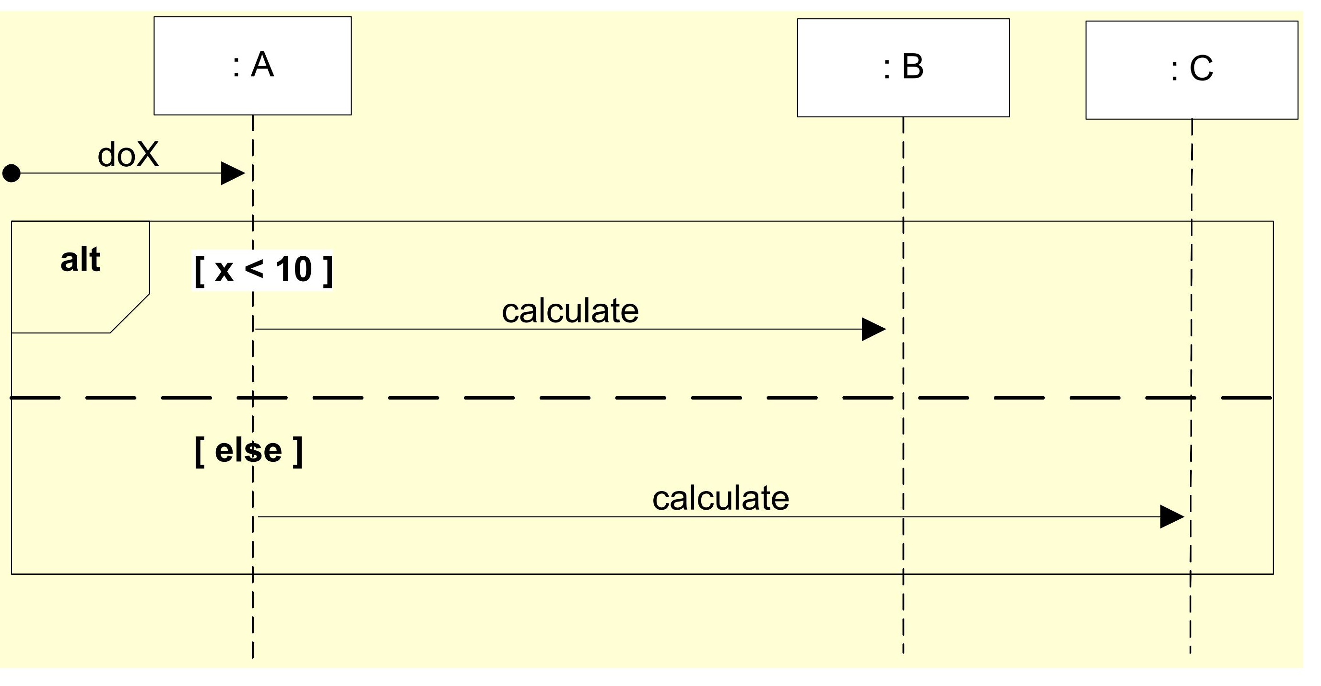
Mutually Exclusive Conditional Messages
Alt frame show mutually exclusive interactions

Slide 36
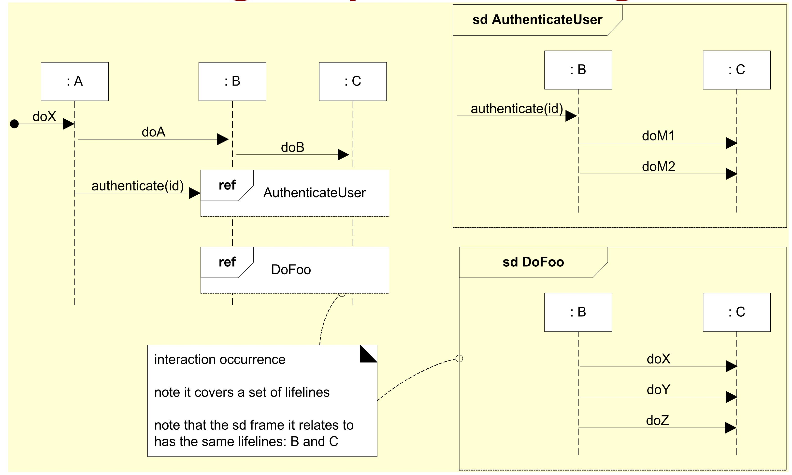
Reference Frames in Sequence Diagrams

Slide 37
Recommended Reading
Chapter # 14 and 15 from Applying UML and Patterns: An Introduction to Object-Oriented Analysis and Design and Iterative Development by Craig Larman, 3rd Edition

